Slide 1
CSAW ‘23
EMBEDDED SECURITY CHALLENGE
Team: SH3RL0CK

Slide 2
SH3RL0CK
IIT MADRAS
Prof. Chester Rebeiro
Arun Krishna AMS
Antonson J
Niranjan Kartha
Surya Prasad

Slide 3
Week 1 Challenge 1
AllWhiteParty
Security system asks for a username and 10-digit password PIN credentials. Uncover them !!
Username: Barry
Password: <Error 404>

Slide 4
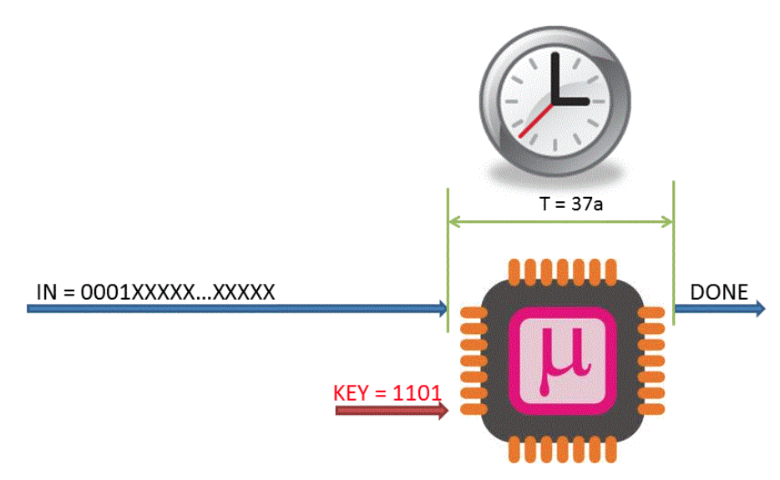
Timing Side-Channels
The amount of time a system takes to operate on a particular input, may reveal private information.

Slide 5
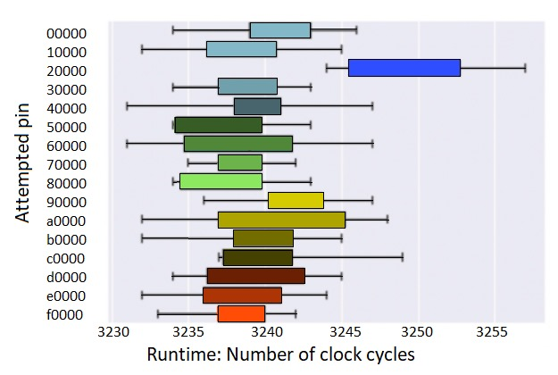
Getting the Username
The more letters matched between our input and the right username, the more time the system took to respond.
Each character match - 0.3 seconds increase in delay
Incrementally built the username [Barry].
Notes:
We obtained the username to be “Barry”. - prev

Slide 6
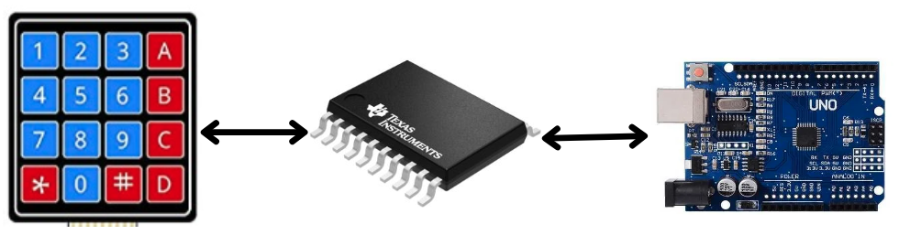
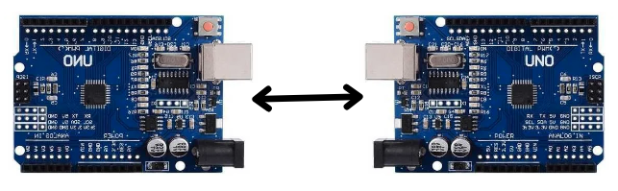
Getting the password
Automating Password entry
Keypad
PCF8574
Victim
The password needs to be input through the keypad manually
Emulated the keypad I2C peripheral using a second Arduino.
Spy
Victim

Slide 7
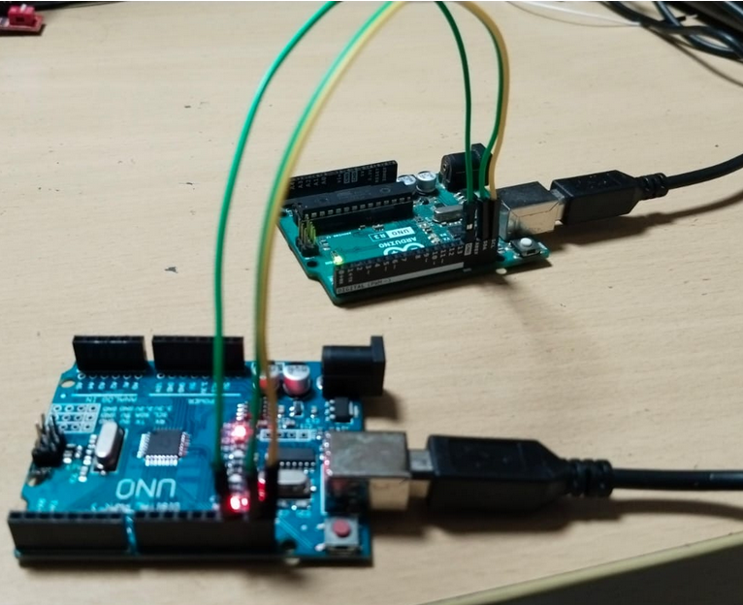
Getting the password
Analyzing the hash
Firmware accepts usernames of the format “Barry[xxxx….x]” i.e.,
only the first characters are checked for equality with “Barry”
Displayed hash depend only on the username and not on the password entered.
Username: Barry
SHA hash: 167 98 212 144 128
Username: Barry123
SHA hash: 164 167 250 75 88

Slide 8
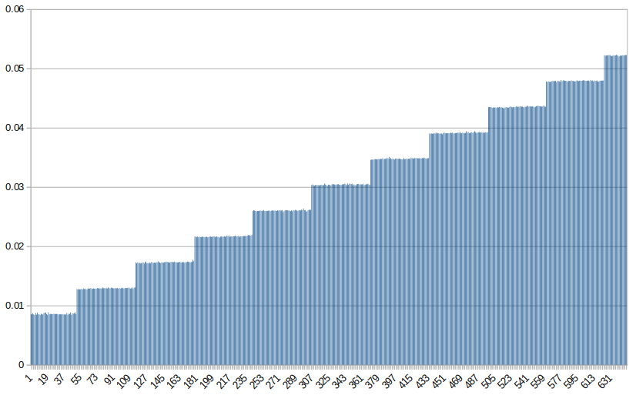
Getting the password
Analyzing the hash
Append zeros to the end of “Barry”
Calculate the response time to the pin entries
For every 64 zeros added, the time increased in steps of 4 milliseconds.
Conclusion: Possible block size of the hash used: 64 bytes

Slide 9
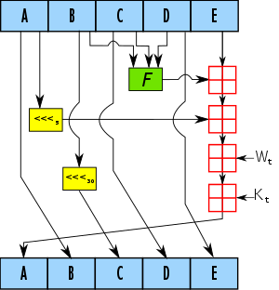
Getting the password
Brute Forcing hash
Time taken for certain pairs of Username & Password was 0.3 seconds - more than usual
Username: Barry
Password: 3805032704
Username: Barry
Password: 3835032704
Username: Barry
Password: 3801032702
Conclusion: Existence of timing side channel

Slide 10
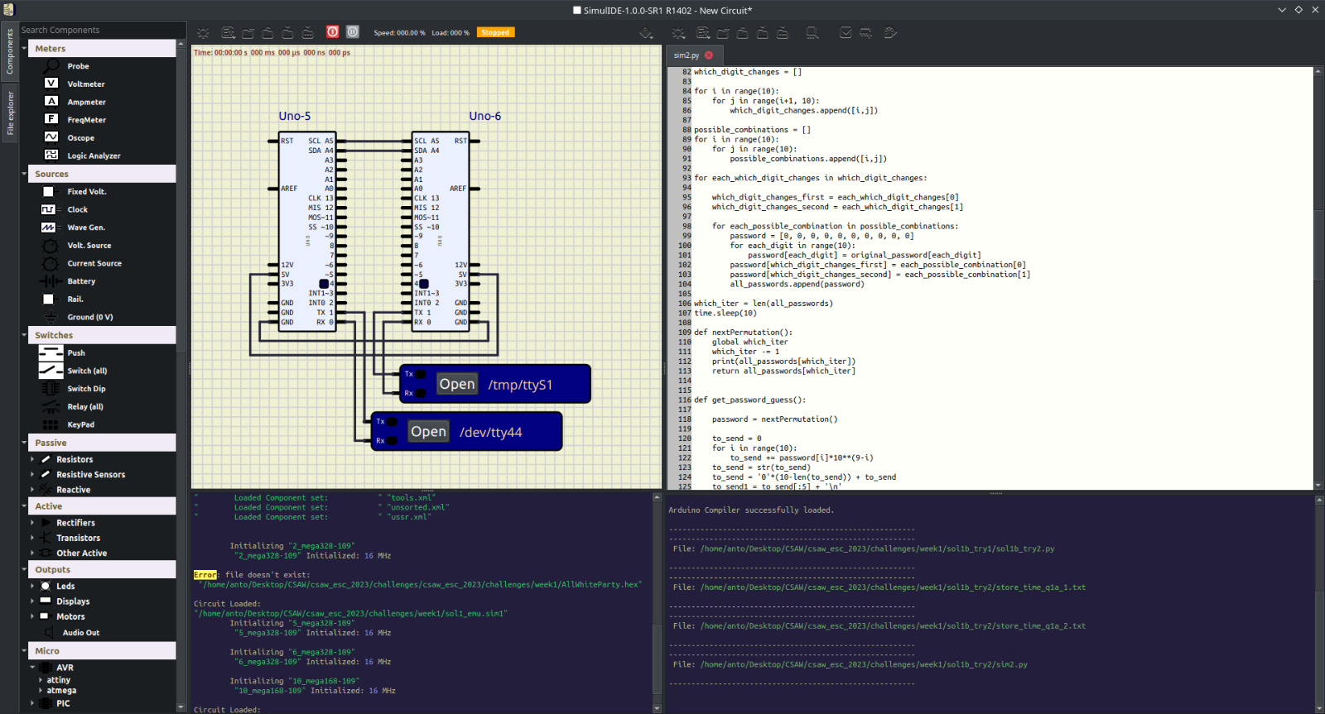

Slide 11
Mitigating timing attack
Reduce Correlation: Introduce random delays into functions
Constant Time Programming: Ensure all possible branches of the function compute in the same amount of time
Notes:
Picture to be added!!

Slide 12
Week 1 Challenge 2
Bluebox
The system plays a series of notes. Can you guess the keys pressed ?
Flag: B339B009

Slide 13

Audio
Side-Channels
The audio signals from a system can reveal information about the system

Slide 14
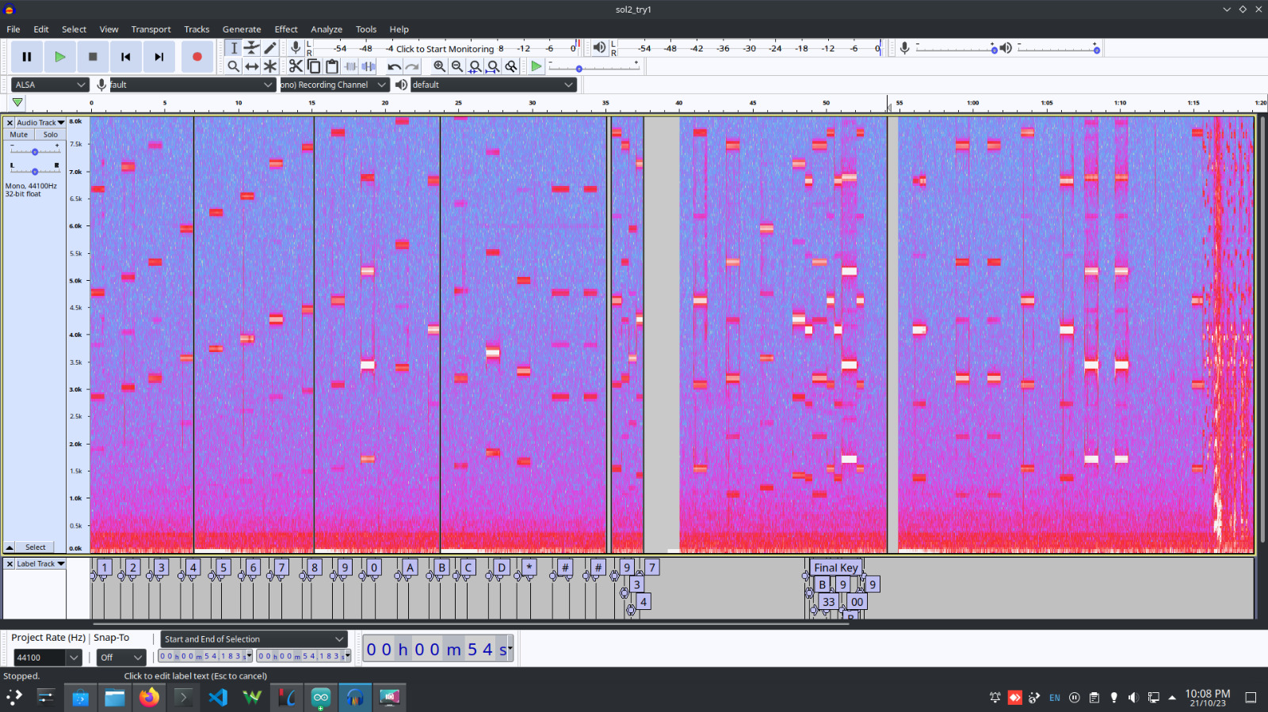
Audio Analysis
The system plays a series of notes.
Pressing each key on keypad played a unique note every time
Key <-> Note unique mapping
Conclusion: Existence of audio side channel
Audacity - open source audio software used for analysis
Notes played corresponding to each key noted.
Match the notes to the audio played earlier

Slide 15
Mitigating audio side-channel leakage
Acoustic analysis: Analysis of information leak through audio channels.
Encryption: Encrypt the audio output. If an attacker captures the audio signal, it will be unintelligible without decryption key
Reduce Correlation:
Noise Injection:
Random noise to the audio signal
Low-pass filters to reduce high frequency tones
Randomly adjust the decibel and frequency
Frequency Hopping: Note played for each key press is randomly changed from a predefined set
Notes:
Picture to be added!!

Slide 16
Week 2 Challenge 1
SPItFire
Here’s your ‘HELLO’ via SPI. Request me the ‘FLAG’
Flag: SPyBURNd

Slide 17

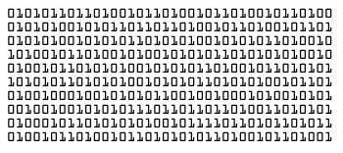
Reverse-engineering
communication protocols
By corresponding communication signals with known messages, the scheme can be reverse-engineered

Slide 18
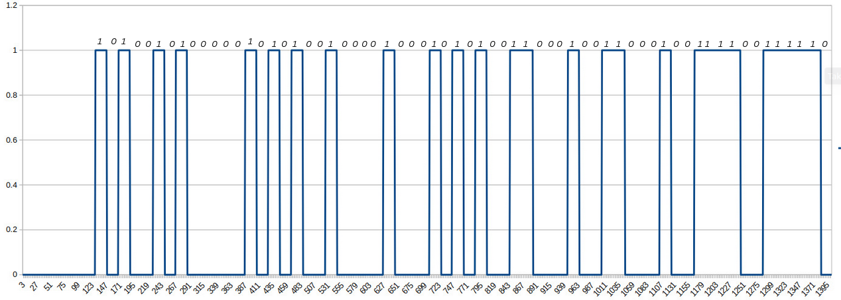
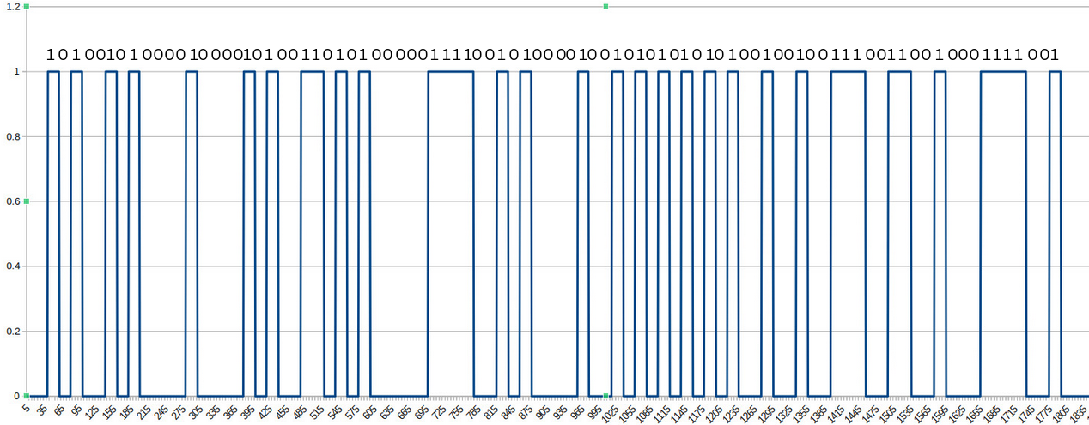
Cracking the Code
Analyzing the communication
Monitor the state of relay
Split the time series data into byte frames to obtain ASCII-encoded image
Message Format:
A5 <len> <text in ASCII> <CRC8>
Initial Message: A5 05 48 45 4C 4C 4F 3E
Flag Message : A5 04 46 41 4C 47 DA
Final Message : A5 08 53 50 42 55 52 4E 64 79

Slide 19
Mitigating Reverse-Engineering Communication Protocols
Confidentiality: Encrypt the data to prevent unauthorized disclosure.
Ex: Encryption Schemes : AES, RSA
Authenticity: Verify the identity of users, devices, or entities involved in a communication or transaction using signatures
Ex: Digital Signature using Asymmetric Cryptography RSA or ECDSA
Integrity: Ensure data remains unaltered and
trustworthy throughout its life cycle.
Ex: MAC and Cryptographic Hash functions
Notes:
Picture to be added!!

Slide 20
Week 2 Challenge 2
czNxdTNuYzM
What’s the next in s3qu3nc3?
A soprano of sound, reaching for the heavens
Flag: 97349616

Slide 21
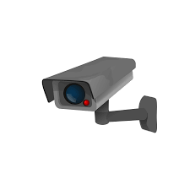
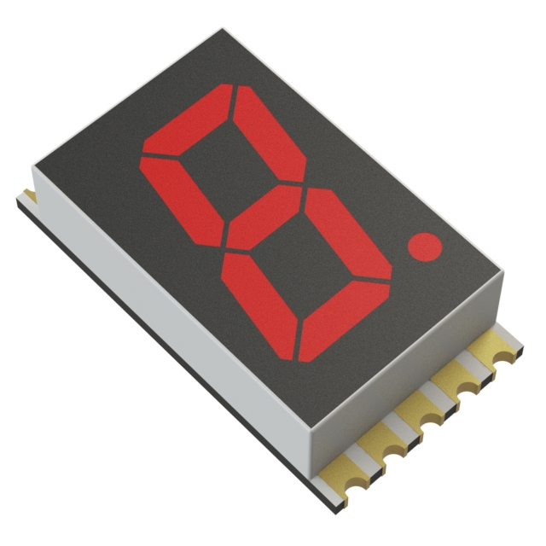
Video Analysis
By recording the system at high speeds and slowing down the footage, we can work out what is happening within it.

Slide 22
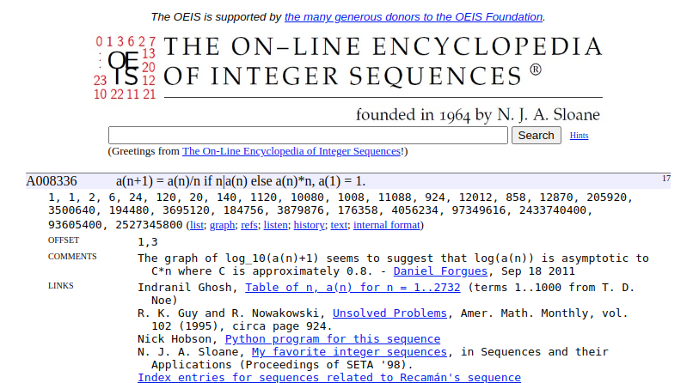
Cracking the Sequence
Recorded the 7-segment display in slow motion
Noted the displayed number sequence
Used OEIS to determine the next in sequence

Slide 23
Mitigating physical side-channel
leakages
Obfuscations: Randomly select mappings from a predefined set to make it more challenging
Post design analysis: Analysis needs to be done for various physical side channels, including light or other potential glitches, for any critical information leakage
Notes:
To be checked

Slide 24
Week 3 Challenge 1
SockAndRoll
Can you help me?
Nope! Send SOS
Flag: <Error 404>

Slide 25

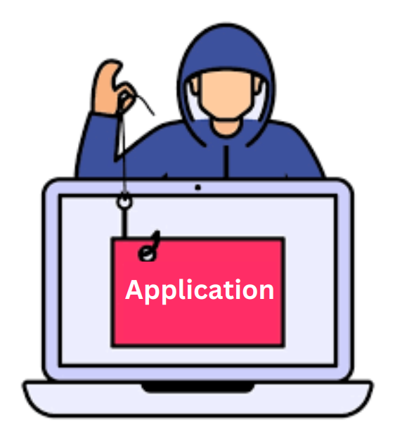
Peripheral Hijacking
By overriding controls of certain peripherals within a system, we may be able to take full control over it.

Slide 26
SOS?
We assumed that the microphone on the system was listening to the buzzer, in order to tell if we were okay or not – disconnecting the buzzer seemed to confirm this.
However, it appeared as if, the only factor affecting whether the system thought that we were okay, was the mere presence of the buzzer and microphone system.
The system seemed to be sensing the impedance of the speaker, and an analog offset outputted by the microphone, and nothing else – muffling the speaker, and grounding the microphone output, seemed to do nothing.

Slide 27
Week 3 Challenge 2
VenderBender
Hit me at the right time, right place, you win!
Flag: mMmCaNdY

Slide 28
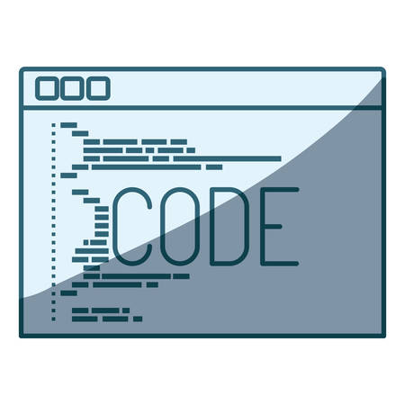

Fault Injection
Send the correct glitch signal at the correct time to inject fault and make the system misbehave

Slide 29
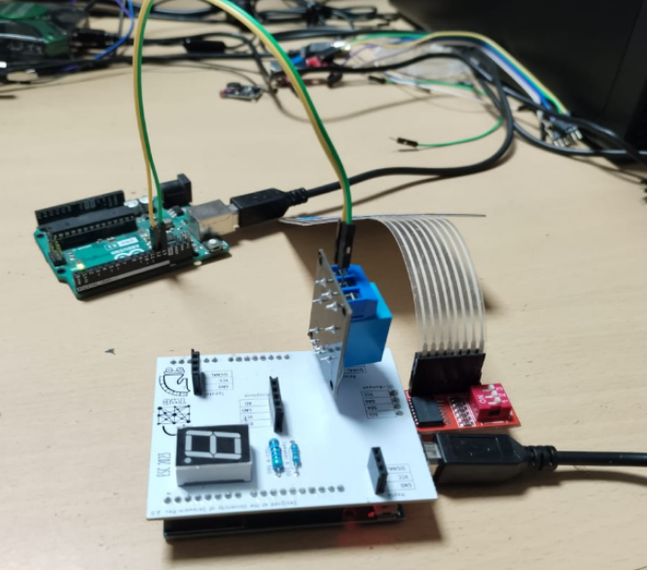
Injecting Faults
Connected an arduino to sense the state of the relay, and fire an interrupt when it detects a rising edge.
Attack Vector :
Glitch signal (send ‘ERR’ through Serial) as soon as it came across a rising edge in the relay state.
On repeatedly thrashing the system at approximately the right instance, the fault is injected and the flag is retrieved

Slide 30
Mitigating Glitch Injection Attacks
Better packaging: Tamper-evident packaging materials and closing of all backdoor entries
Fuzzing: Fuzz testing is to discover potential faults, vulnerabilities & unexpected behaviour in the system
Notes:
To be checked

Slide 31
Thank You

Slide 32
VenderBender
By briefly cutting off power to a system at very specific times, we can cause it to misbehave in a way advantageous to us.
Fault Injection

Slide 33
Cybersecurity Infographics
AllWhiteParty
czNxdTNuYzM
Timing attack
Video-based
BlueBox
SockAndRoll
Audio side channel
Application hijacking
SPitFire
VenderBender
Communication protocols
Fault injection

Slide 34
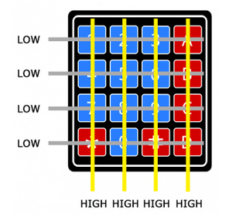
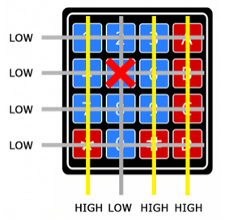
Getting the password
Automating Password entry
The password needs to be input through the keypad manually
Emulated the keypad I2C peripheral using a second Arduino.

Slide 35
Cybersecurity Infographics
MERCURY
VENUS
MARS
It’s a very small planet
Venus has a beautiful name
Mars is a cold place
JUPITER
NEPTUNE
SATURN
Jupiter is the biggest planet
It’s the farthest planet
Yes, Saturn is the ringed one

Slide 36
Cybersecurity Infographics
MERCURY
MARS
Mercury is the smallest planet
Mars is actually a cold place
VENUS
NEPTUNE
Venus has a beautiful name
It’s the farthest planet
JUPITER
SATURN
Jupiter is the biggest planet
Yes, Saturn is the ringed one

Slide 37
Cybersecurity Infographics
MERCURY
MARS
Mercury is the smallest planet
Mars is actually a cold place
JUPITER
SATURN
Jupiter is the biggest planet
Yes, Saturn is the ringed one

Slide 38
Cybersecurity Infographics
MERCURY | Mercury is the closest planet to the Sun
NEPTUNE | Neptune is the farthest planet from the Sun
MARS | Despite being red, Mars is actually a cold place
VENUS | Venus has a beautiful name, but it’s very hot

Slide 39
Cybersecurity Infographics
MERCURY
MARS
Mercury is the smallest planet
Mars is actually a cold place
JUPITER
SATURN
Jupiter is the biggest planet
Yes, Saturn is the ringed one

Slide 40
Cybersecurity Infographics
MERCURY
Mercury is the smallest and innermost planet
It’s the farthest
planet from the Sun
NEPTUNE
MARS
Despite being red, Mars is a very cold place
Venus is the second planet from the Sun
VENUS

Slide 41
Cybersecurity Infographics
01
02
03
04
MERCURY
MARS
JUPITER
VENUS
It's the closest planet to the Sun
Despite being red, Mars is a cold place
It's a gas giant and the biggest planet
Venus is the second planet to the Sun

Slide 42
Cybersecurity Infographics
MERCURY
MARS
JUPITER
VENUS
SATURN
It's the closest planet to the Sun
Despite being red, Mars is a cold place
It's a gas giant and the biggest planet
Venus is the second planet to the Sun
Yes, Saturn is the ringed one

Slide 43
Cybersecurity Infographics
MERCURY
MARS
Mercury is the smallest planet
Mars is actually a cold place
VENUS
NEPTUNE
Venus has a beautiful name
It’s the farthest planet

Slide 44
Cybersecurity Infographics
MERCURY
VENUS
MARS
It’s a very small planet
Venus has a beautiful name
Mars is a cold place
JUPITER
NEPTUNE
SATURN
Jupiter is the biggest planet
It’s the farthest planet
Yes, Saturn is the ringed one

Slide 45
Cybersecurity Infographics
MERCURY
MARS
Mercury is the smallest planet
Mars is actually a cold place
VENUS
NEPTUNE
Venus has a beautiful name
It’s the farthest planet
JUPITER
SATURN
Jupiter is the biggest planet
Yes, Saturn is the ringed one

Slide 46
Cybersecurity Infographics
MERCURY
MARS
Mercury is the smallest planet
Mars is actually a cold place
VENUS
NEPTUNE
Venus has a beautiful name
It’s the farthest planet
JUPITER
SATURN
Jupiter is the biggest planet
Yes, Saturn is the ringed one

Slide 47
Cybersecurity Infographics
MERCURY
MARS
JUPITER
VENUS
It's the closest planet to the Sun
Despite being red, Mars is a cold place
It's a gas giant and the biggest planet
Venus is the second planet to the Sun

Slide 48
Cybersecurity Infographics
MERCURY
Mercury is the smallest planet
VENUS
NEPTUNE
Venus has a beautiful name
It’s the farthest planet
JUPITER
SATURN
Jupiter is the biggest planet
Yes, Saturn is the ringed one

Slide 49
Cybersecurity Infographics
MERCURY
MARS
JUPITER
VENUS
It's the closest planet to the Sun
Despite being red, Mars is a cold place
It's a gas giant and the biggest planet
Venus is the second planet to the Sun

Slide 50
Cybersecurity Infographics
MERCURY
MARS
Mercury is the smallest planet
Mars is actually a cold place
VENUS
NEPTUNE
Venus has a beautiful name
It’s the farthest planet
JUPITER
SATURN
Jupiter is the biggest planet
Yes, Saturn is the ringed one

Slide 51
Cybersecurity Infographics
Mercury is the smallest planet of them all
Neptune is the farthest planet from the Sun
JUPITER
VENUS
MERCURY
NEPTUNE
Jupiter is the fifth planet from the Sun and the largest
Venus is the second planet from the Sun. It has a beautiful name

Slide 52
Cybersecurity Infographics
MERCURY
MARS
Mercury is the smallest planet
Mars is actually a cold place
VENUS
NEPTUNE
Venus has a beautiful name
It’s the farthest planet
JUPITER
SATURN
Jupiter is the biggest planet
Yes, Saturn is the ringed one

Slide 53
Cybersecurity Infographics
JUPITER
Jupiter is the fifth planet from the Sun
NEPTUNE
Neptune is the farthest planet from the Sun
SATURN
Mercury is the smallest planet of them all

Slide 54
Cybersecurity Infographics
EARTH
MERCURY
VENUS
MARS
Mercury is the closest planet
Venus has a beautiful name
Mars is a cold place
JUPITER
NEPTUNE
SATURN
Jupiter is the biggest planet
It’s the farthest planet
Yes, Saturn is the ringed one

Slide 55
Cybersecurity Infographics
Mercury is the closest planet to the Sun and the smallest one in the Solar System
1
Jupiter is a gas giant and actually also the biggest planet in the Solar System
2
Saturn is a gas giant in the Solar System, composed mostly of hydrogen and helium
3
Venus has a beautiful name and is the second planet from the Sun

Slide 56
Cybersecurity Infographics
EARTH
NEPTUNE
MARS
MERCURY
Earth is the third planet from the Sun
It’s the farthest planet from the Sun
Despite being red, Mars is a cold place
Mercury is the closest object to the Sun

Slide 57
Cybersecurity Infographics
Venus is the second planet from the Sun
Venus is the second planet from the Sun
Neptune is the farthest known planet
Jupiter is the fifth planet from the Sun
Mercury is the smallest planet

Slide 58
Cybersecurity Infographics
MERCURY
VENUS
Mercury is the closest planet
Venus has a beautiful name
JUPITER
NEPTUNE
Jupiter is the biggest planet
It’s the farthest planet

Slide 59
Cybersecurity Infographics
NEPTUNE
MARS
JUPITER
Neptune is the farthest planet from the Sun
Despite being red, Mars is a cold place
Jupiter is a gas giant and the biggest planet
EARTH
SATURN
MERCURY
Earth is the third planet from the Sun
It’s composed of hydrogen and helium
Mercury is the closest object to the Sun

Slide 60
Cybersecurity Infographics
Despite being red, Mars is a cold place
It’s the farthest planet from the Sun
Jupiter the biggest planet of them all
Mercury closest planet to the Sun
MARS
NEPTUNE
JUPITER
MERCURY

Slide 61
Cybersecurity Infographics
EARTH
NEPTUNE
MARS
MERCURY
Earth is the third planet from the Sun
It’s the farthest planet from the Sun
Despite being red, Mars is a cold place
Mercury is the closest object to the Sun

Slide 62
Cybersecurity Infographics
MERCURY
MARS
Mercury is the smallest planet
Mars is actually a cold place
VENUS
NEPTUNE
Venus has a beautiful name
It’s the farthest planet
EARTH
JUPITER
SATURN
Jupiter is the biggest planet
Is the third planet from the Sun
Yes, Saturn is the ringed one

Slide 63
Instructions for use (premium users)
In order to use this template, you must be a Premium user on Slidesgo.
You are allowed to:
Modify this template.
Use it for both personal and commercial purposes.
Hide or delete the “Thanks” slide and the mention to Slidesgo in the credits.
Share this template in an editable format with people who are not part of your team.
You are not allowed to:
Sublicense, sell or rent this Slidesgo Template (or a modified version of this Slidesgo Template).
Distribute this Slidesgo Template (or a modified version of this Slidesgo Template) or include it in a database or in any other product or service that offers downloadable images, icons or presentations that may be subject to distribution or resale.
Use any of the elements that are part of this Slidesgo Template in an isolated and separated way from this Template.
Register any of the elements that are part of this template as a trademark or logo, or register it as a work in an intellectual property registry or similar.
For more information about editing slides, please read our FAQs or visit Slidesgo School:
https://slidesgo.com/faqs and https://slidesgo.com/slidesgo-school

Slide 64
Infographics
You can add and edit some infographics to your presentation to show your data in a visual way.
Choose your favourite infographic and insert it in your presentation using Ctrl C + Ctrl V or Cmd C + Cmd V in Mac.
Select one of the parts and ungroup it by right-clicking and choosing “Ungroup”.
Change the color by clicking on the paint bucket.
Then resize the element by clicking and dragging one of the square-shaped points of its bounding box (the cursor should look like a double-headed arrow). Remember to hold Shift while dragging to keep the proportions.
Group the elements again by selecting them, right-clicking and choosing “Group”.
Repeat the steps above with the other parts and when you’re done editing, copy the end result and paste it into your presentation.
Remember to choose the “Keep source formatting” option so that it keeps the design. For more info, please visit Slidesgo School.

